Slide 1

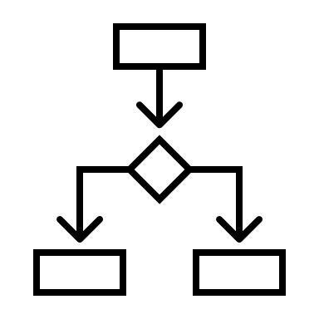
Research Delivery
Putting research into action
Carrying out of all study activities in accordance with the study protocol and agreed local Standards Of Practice (SOP)
Research is usually conducted by a team of people such as research nurses, trial co-ordinators and statisticians
Understanding a clinical services pathway will help identify where, when, and how to identify, screen and recruit participants
The Chief Investigator (CI) is responsible for the study across all organisations. The Principal Investigator (PI) is responsible for the study at the local organisation
Before collecting data, people must provide informed consent, agreeing to take part in the research
All members of the research team have different training requirements before starting the study
How research is conducted is outlined in a study protocol
Top 3 tips
R&D
Work with your local Research and Development team to help with research delivery
TEAMWORK
Working as a team will result in smoother research delivery
Pathways
Really understand the normal clinical pathways for the patient population

Slide 2
MEDICAL INFOGRAPHIC
Make a big impact with our professional slides and charts
TITLE 01
Make a big impact with professional slides, charts, infographics and more.
TITLE 02
Make a big impact with professional slides, charts, infographics and more.
TITLE 03
Make a big impact with professional slides, charts, infographics and more.

Slide 3
MARKETING INFOGRAPHIC
WRITE YOUR SUBTITLE HERE
YOUR TITLE
YOUR TITLE
Green marketing is a practice whereby companies seek to go above and beyond traditional.
Green marketing is a practice whereby companies seek to go above and beyond traditional.
YOUR TITLE
YOUR TITLE
Green marketing is a practice whereby companies seek to go above and beyond traditional.
Green marketing is a practice whereby companies seek to go above and beyond traditional.
YOUR TITLE
YOUR TITLE
Green marketing is a practice whereby companies seek to go above and beyond traditional.
Green marketing is a practice whereby companies seek to go above and beyond traditional.

Slide 4

???
Research Delivery
putting research into action
carrying out of all study activities in accordance with the study protocol and agreed local Standards Of Practice (SOP)
Understand your audience: decide who is going to read your work and select an appropriate journal. Be familiar with the journal’s author guidelines and read other articles they have published.
Construct a template: following the author guidelines, produce a template with all the necessary headings and any subheadings that you think will be important for your work.
Get it all out: the first draft will likely be far too big and will need significant revisions. This is ok. It will help to see all the work in one place. Do not worry about refining at this stage, just write.
Reduce and refine: this draft is about practicing brevity and succinctness; communicating your work successfully in the least number of words. The most important consideration here is to refine for your readership.
Craft for clarity: editing and revising in this stage is the most challenging. Ensuring accuracy of language, rhythm and flow of the narrative, and interest and appeal to the reader are the key objectives.
Top 3 tips
#1
Comprehensive
Cover all the necessary details – check for a reporting standard
#2
Accurate
Ensure that what you write truly reflects what you mean
#3
Succinct
Say it in the least number of words possible
Myth busting!
Legend has it that academic writing has to be complex and full of jargon.
This is a myth.
Of course, there are topics that have specific words to describe specific things. For example, a randomised controlled trial is three words to label a more complex process, and you might not need to describe that more complex process in your academic publication . However beyond this, plain English is best used. There is no need to use a thesaurus to make what your writing about seem more clever.

Slide 5
MARKETING INFOGRAPHIC
WRITE YOUR SUBTITLE HERE
YOUR TITLE
YOUR TITLE
Green marketing is a practice whereby companies seek to go above and beyond traditional.
Green marketing is a practice whereby companies seek to go above and beyond traditional.
YOUR TITLE
YOUR TITLE
Green marketing is a practice whereby companies seek to go above and beyond traditional.
Green marketing is a practice whereby companies seek to go above and beyond traditional.
YOUR TITLE
YOUR TITLE
Green marketing is a practice whereby companies seek to go above and beyond traditional.
Green marketing is a practice whereby companies seek to go above and beyond traditional.

